Slide 1
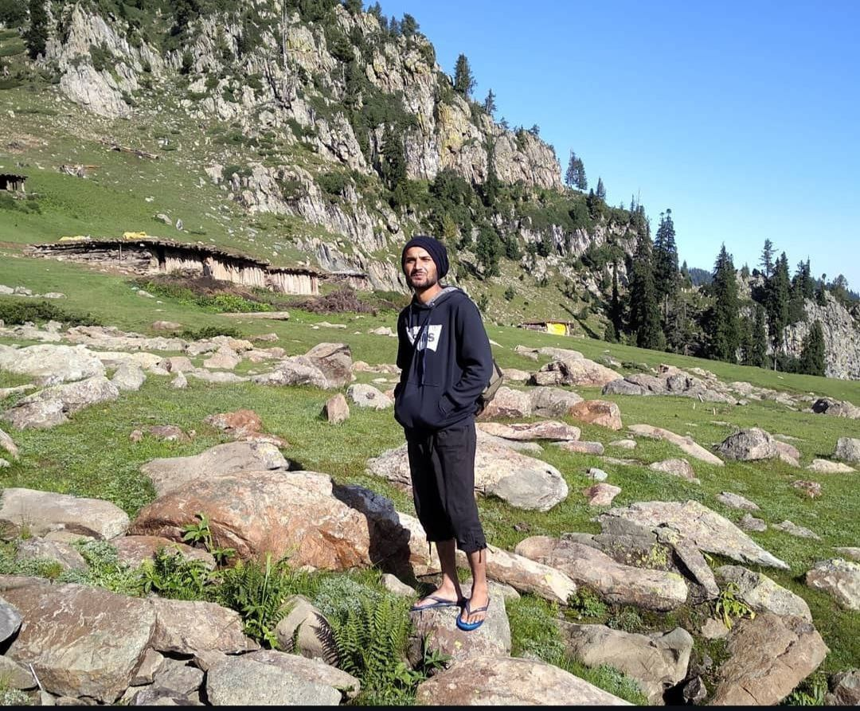
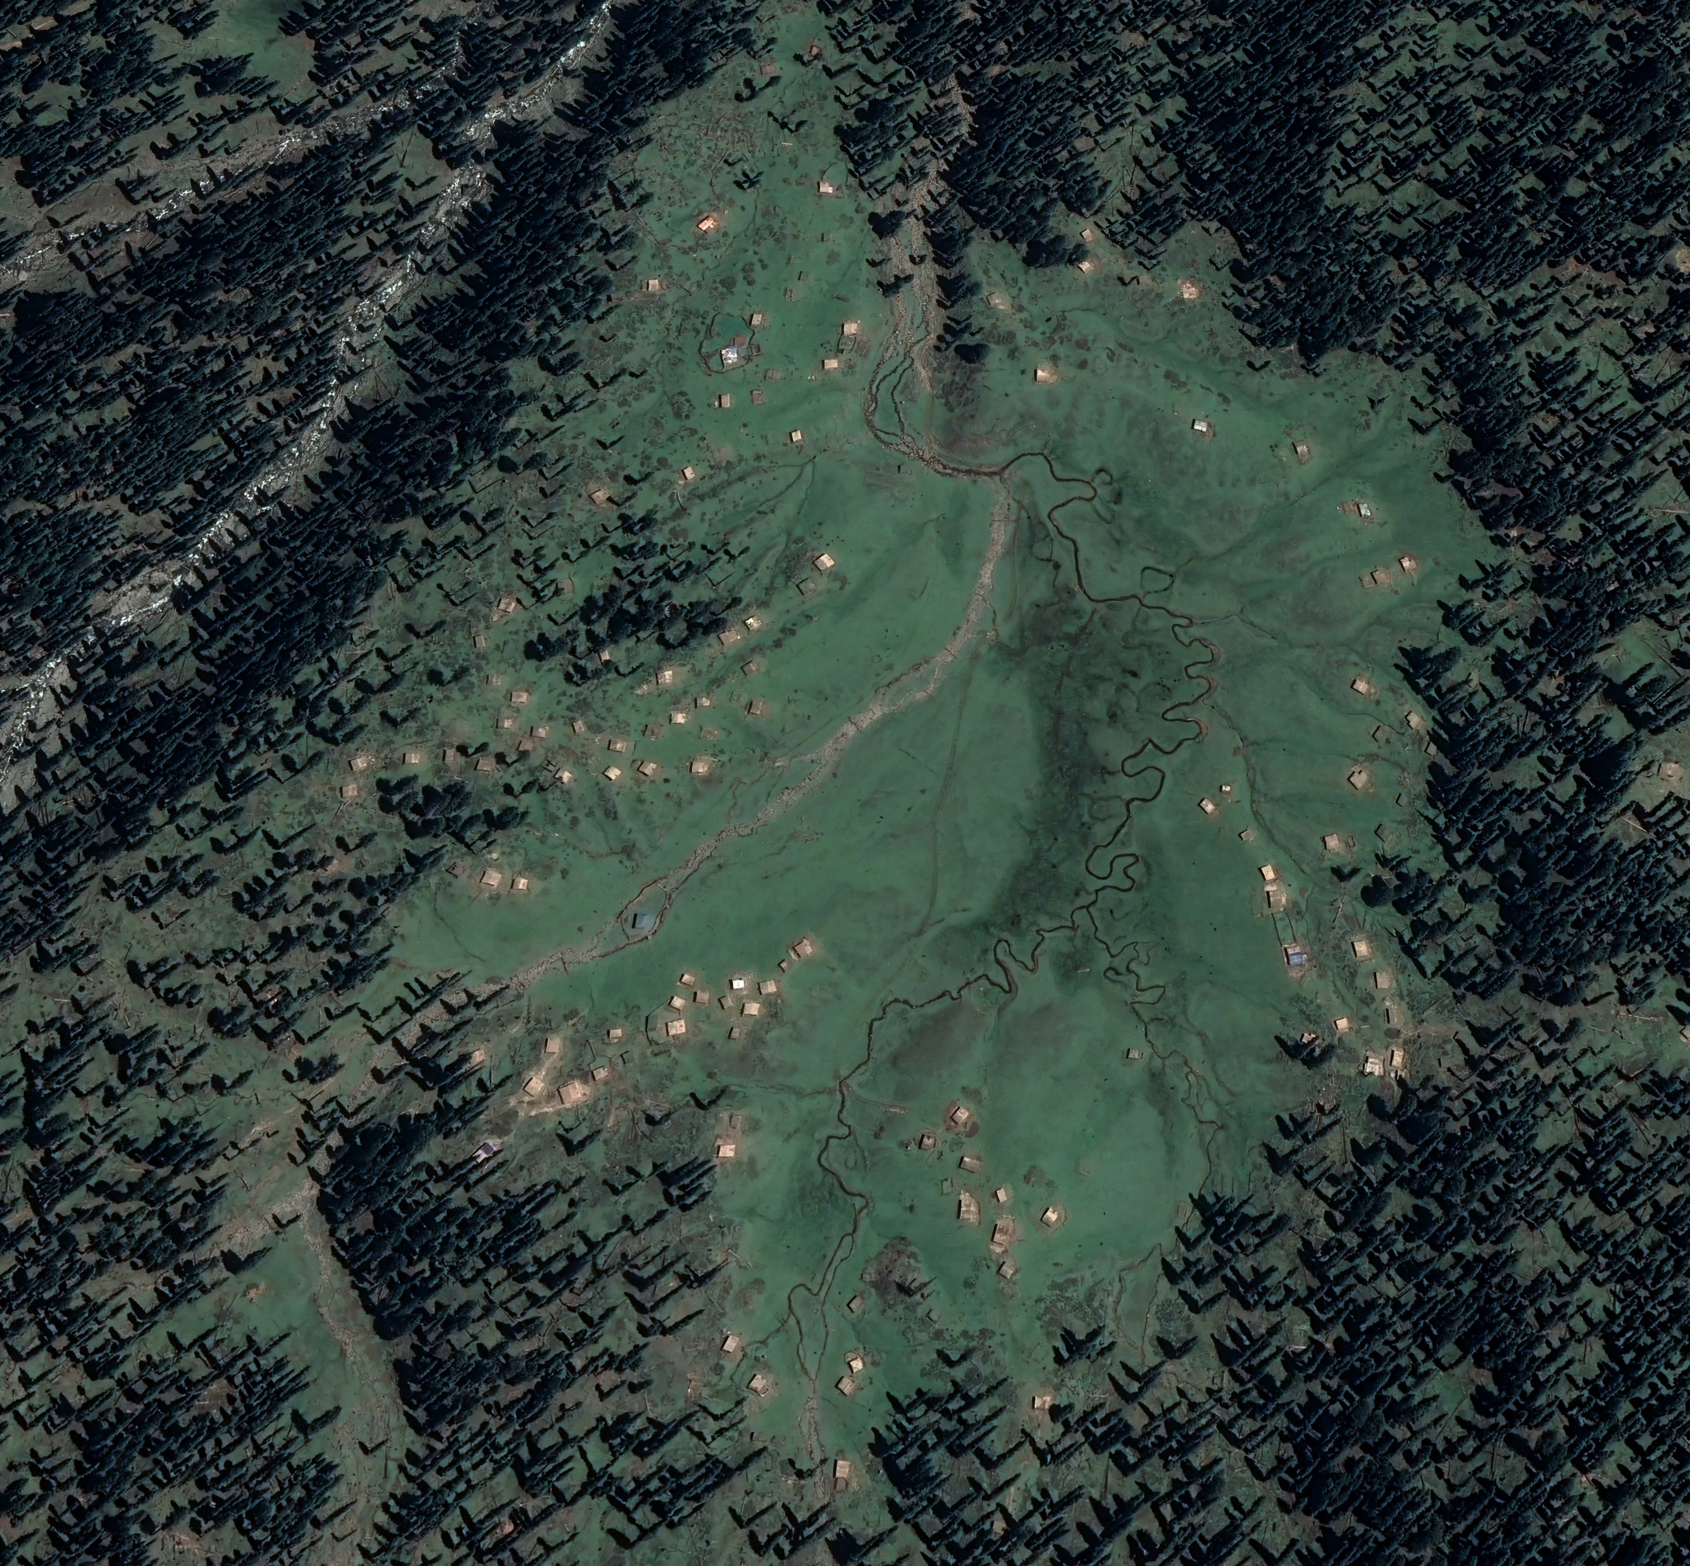
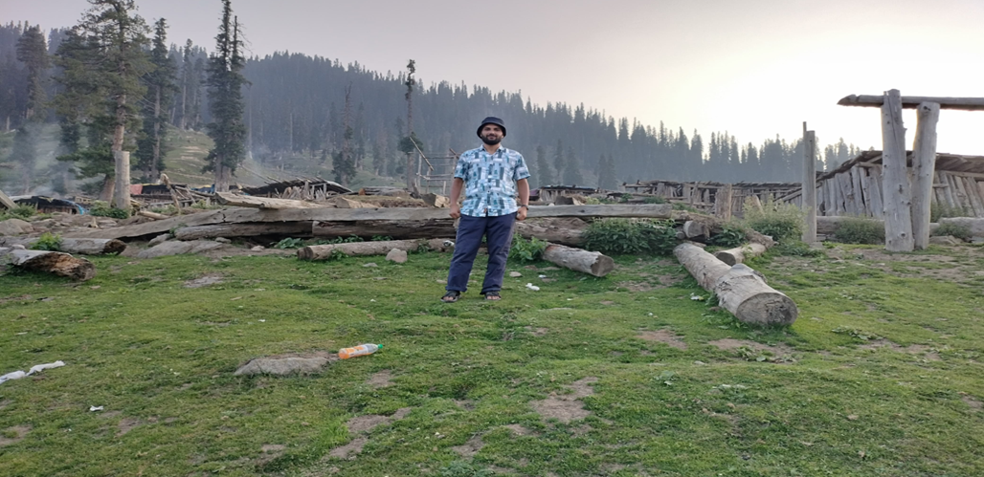
Restoration and Management Strategy for Lal Marg and Mohand Marg
Presented by
Shahid Saleem
RISG-SA Team Co-Founder Himalayan Pastoral Trust

Slide 2
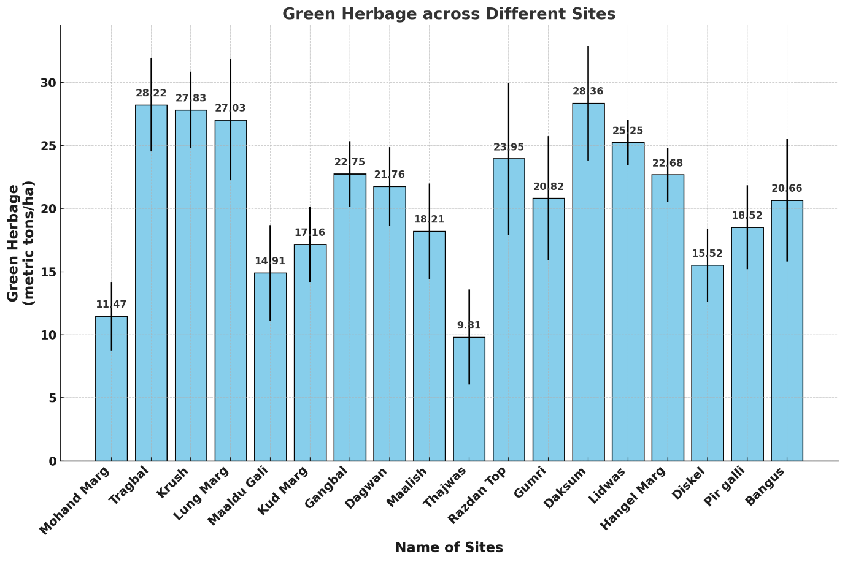
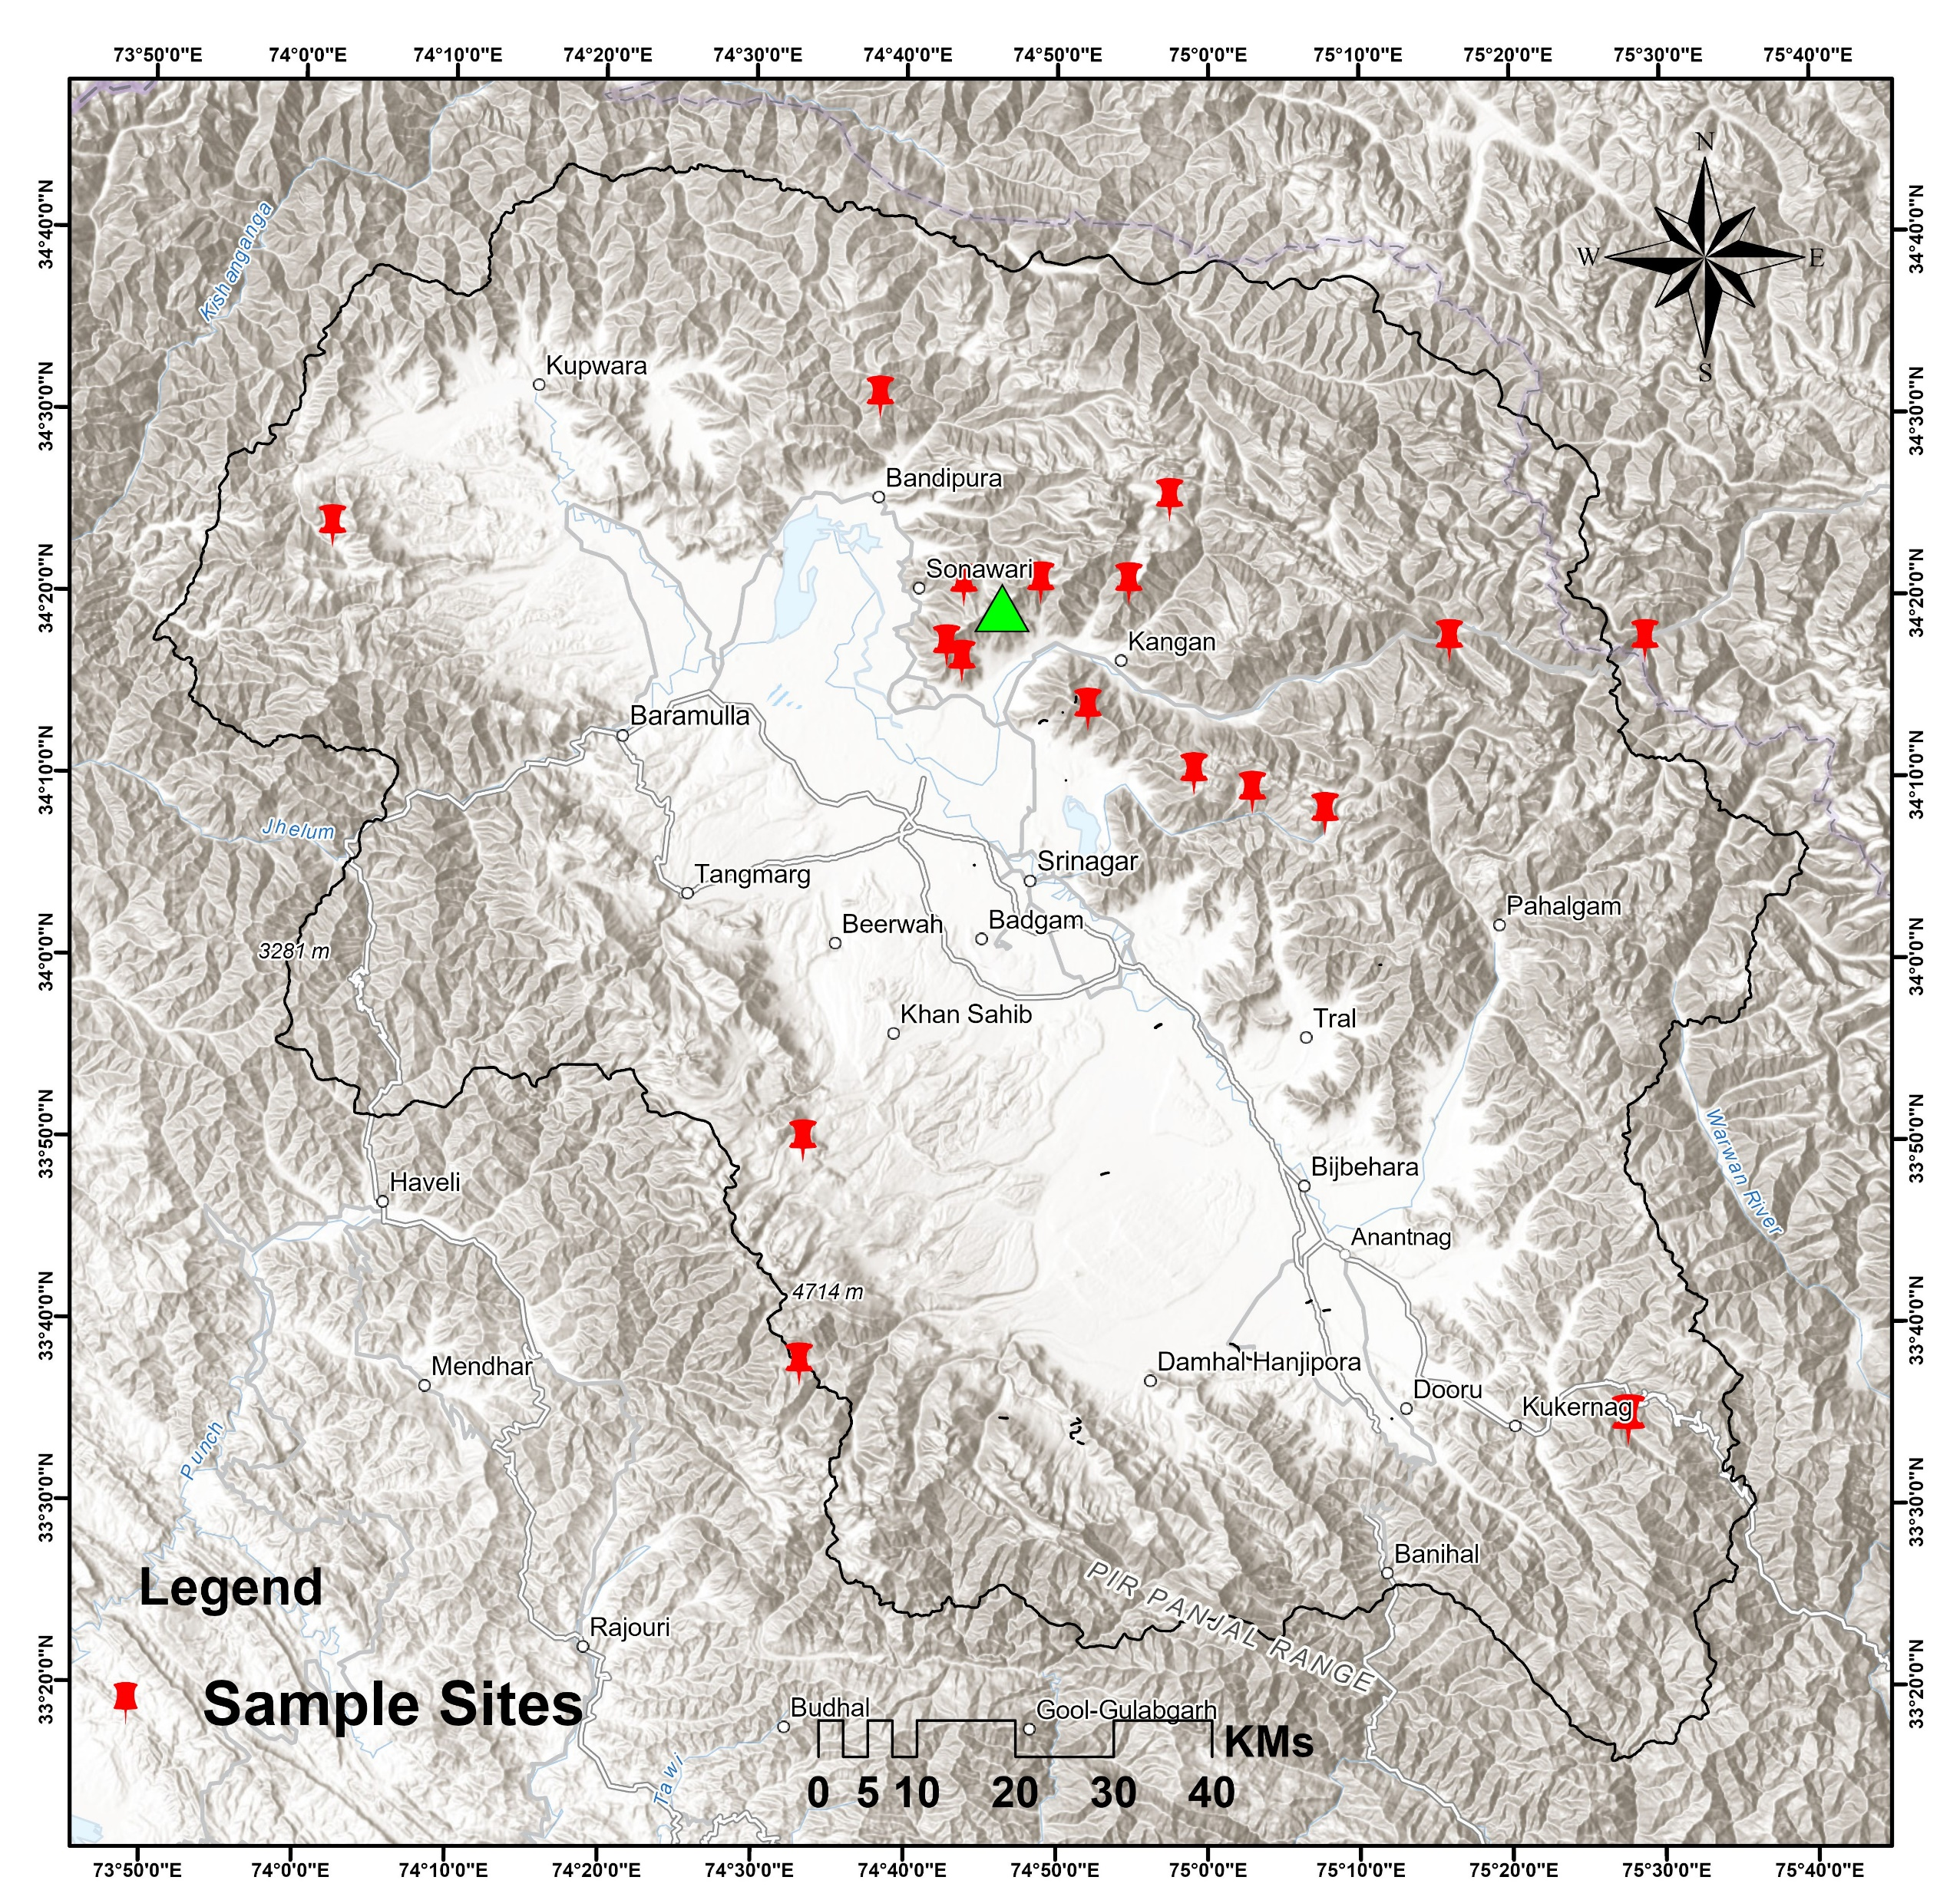
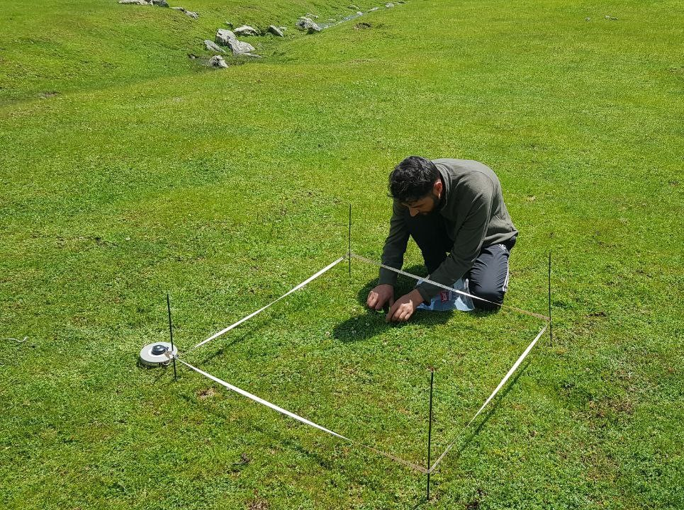
Problem Statement;
Grasslands like Mohand Marg is facing significant degradation due to overgrazing, and insufficient management practices (Shahid et al 2023).
Low forage production that has impacted pastoralists, reducing their average herd size from 100-150 to 30-35 Over the years.
This project aims to develop and implement targeted pasture restoration strategies in Mohand Marg/Lal Marg.

Slide 3
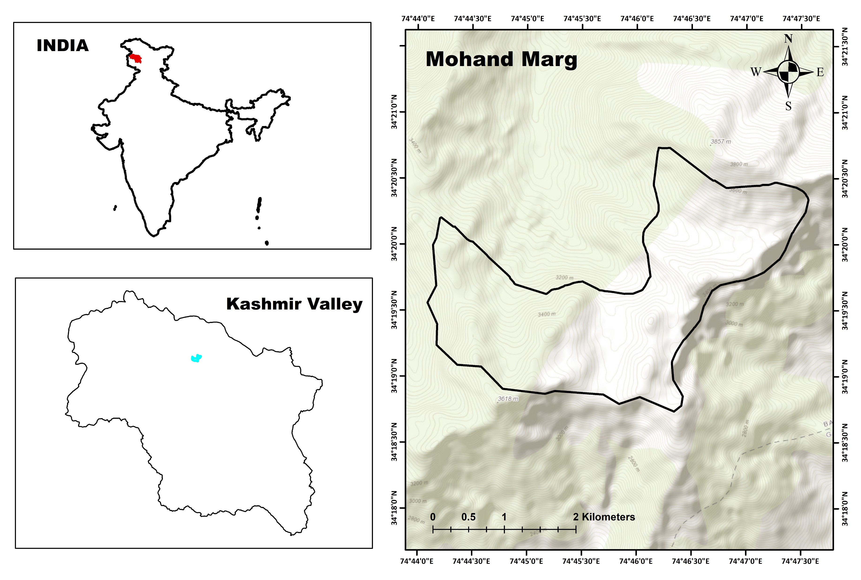
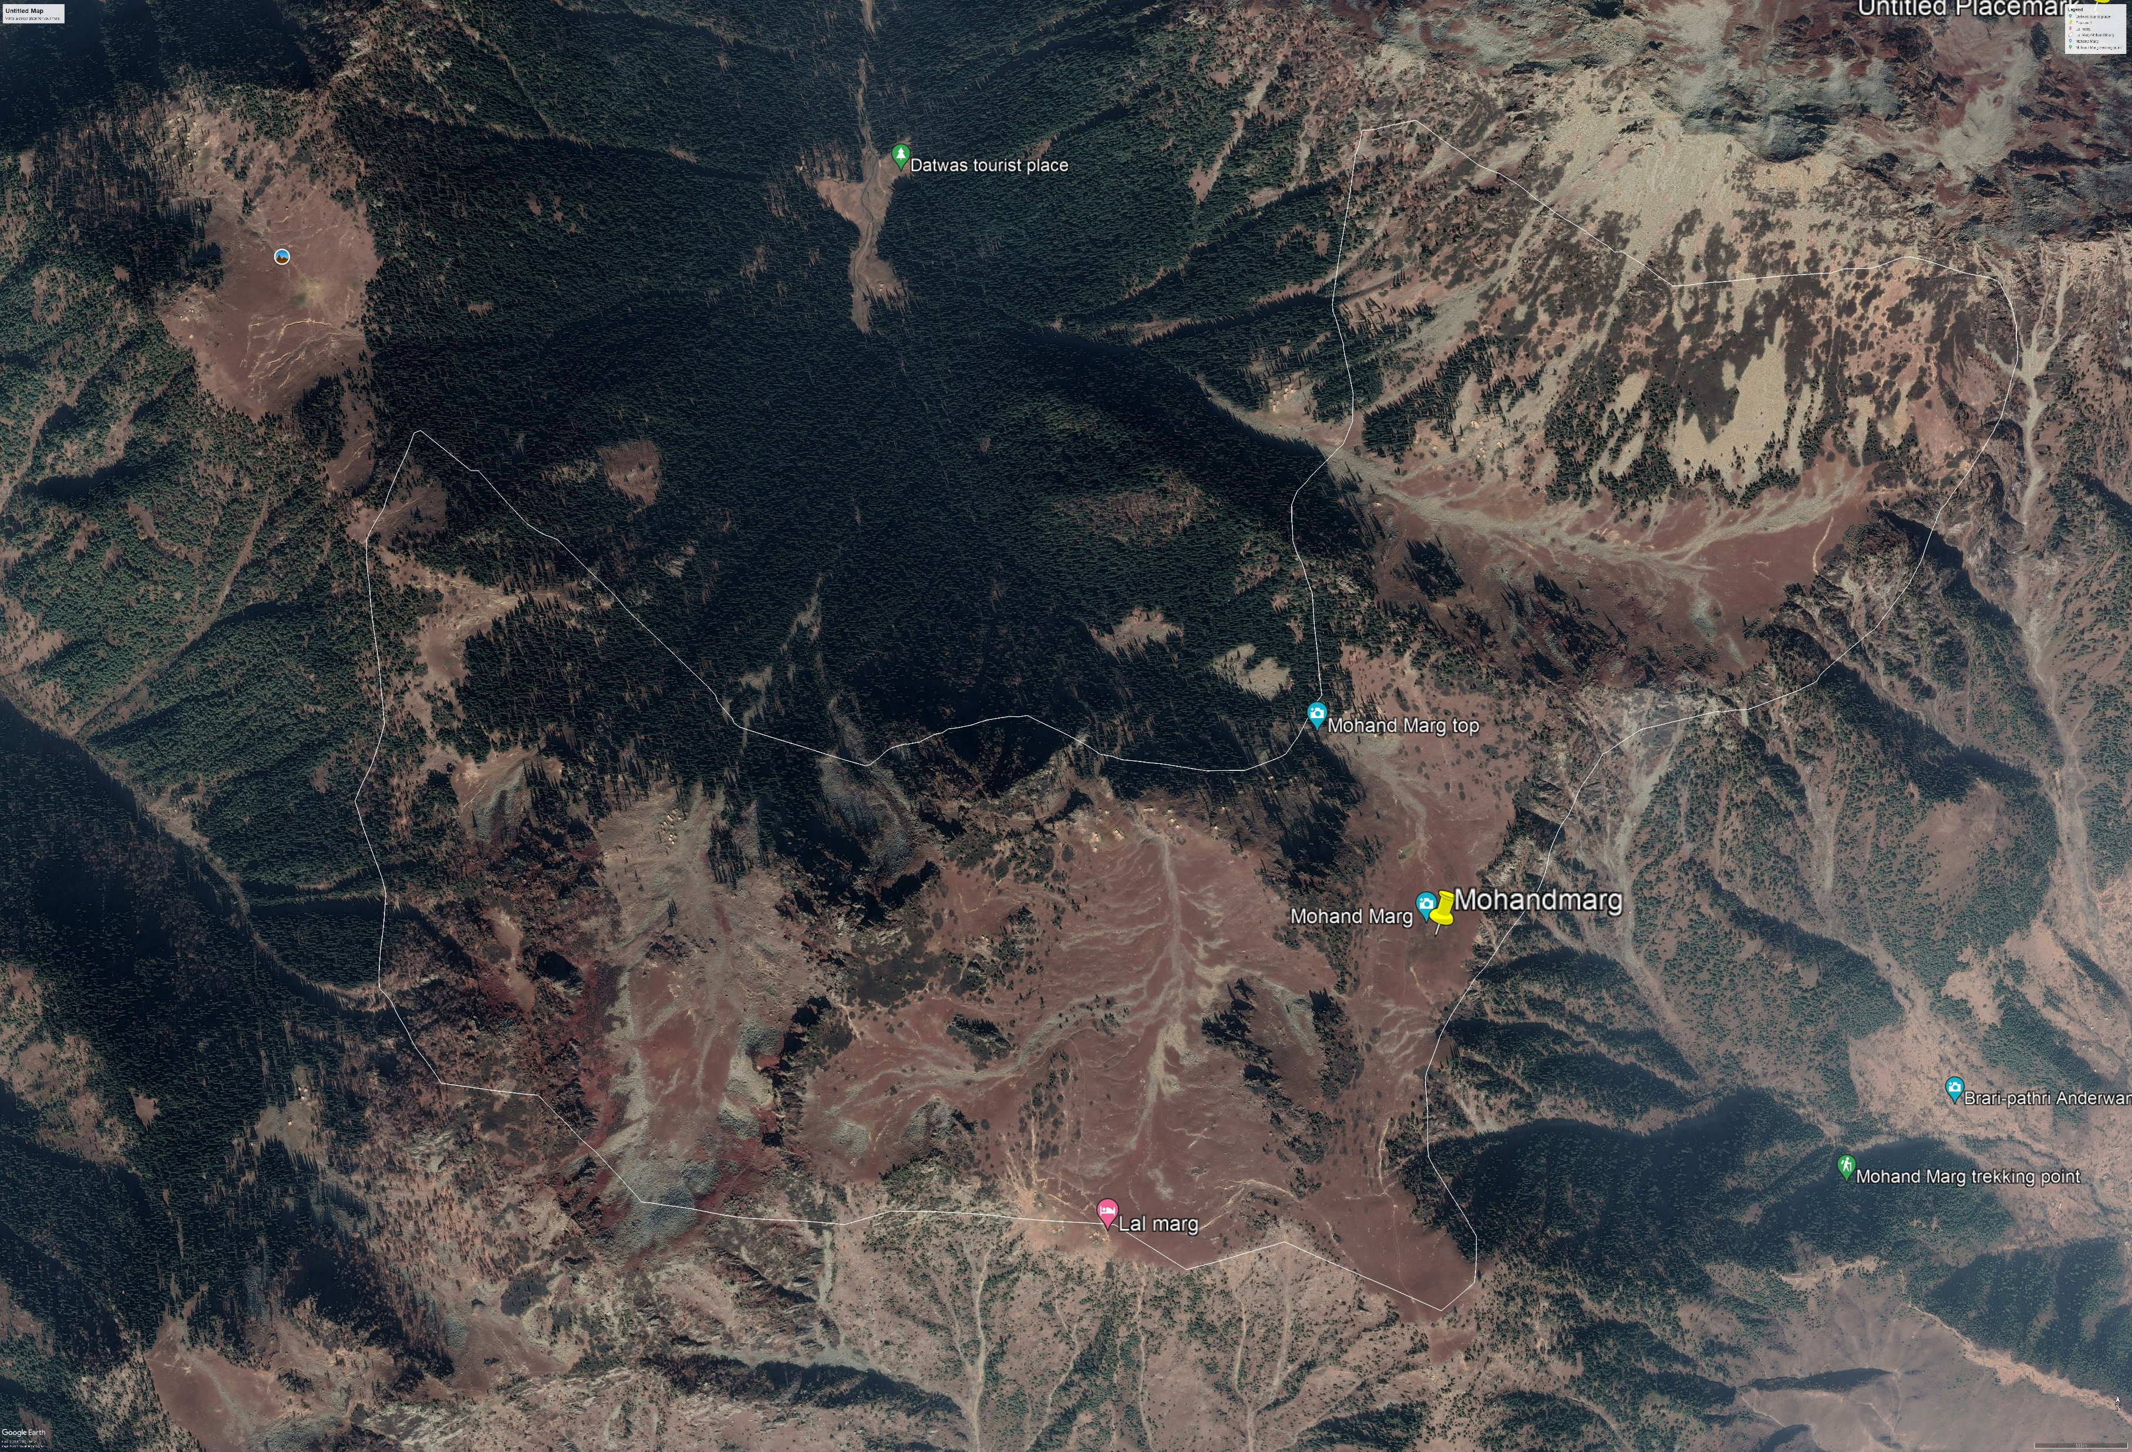
Location of Proposed Restoration site; Mohand Marg
Area; 461 hectare
Pastoral Households; 105
Total Population: 840
Grazing Season May to Oct
Carrying Capacity: in Sheep units 13.59
Biomass Production:11.47MT/ ha

Slide 4
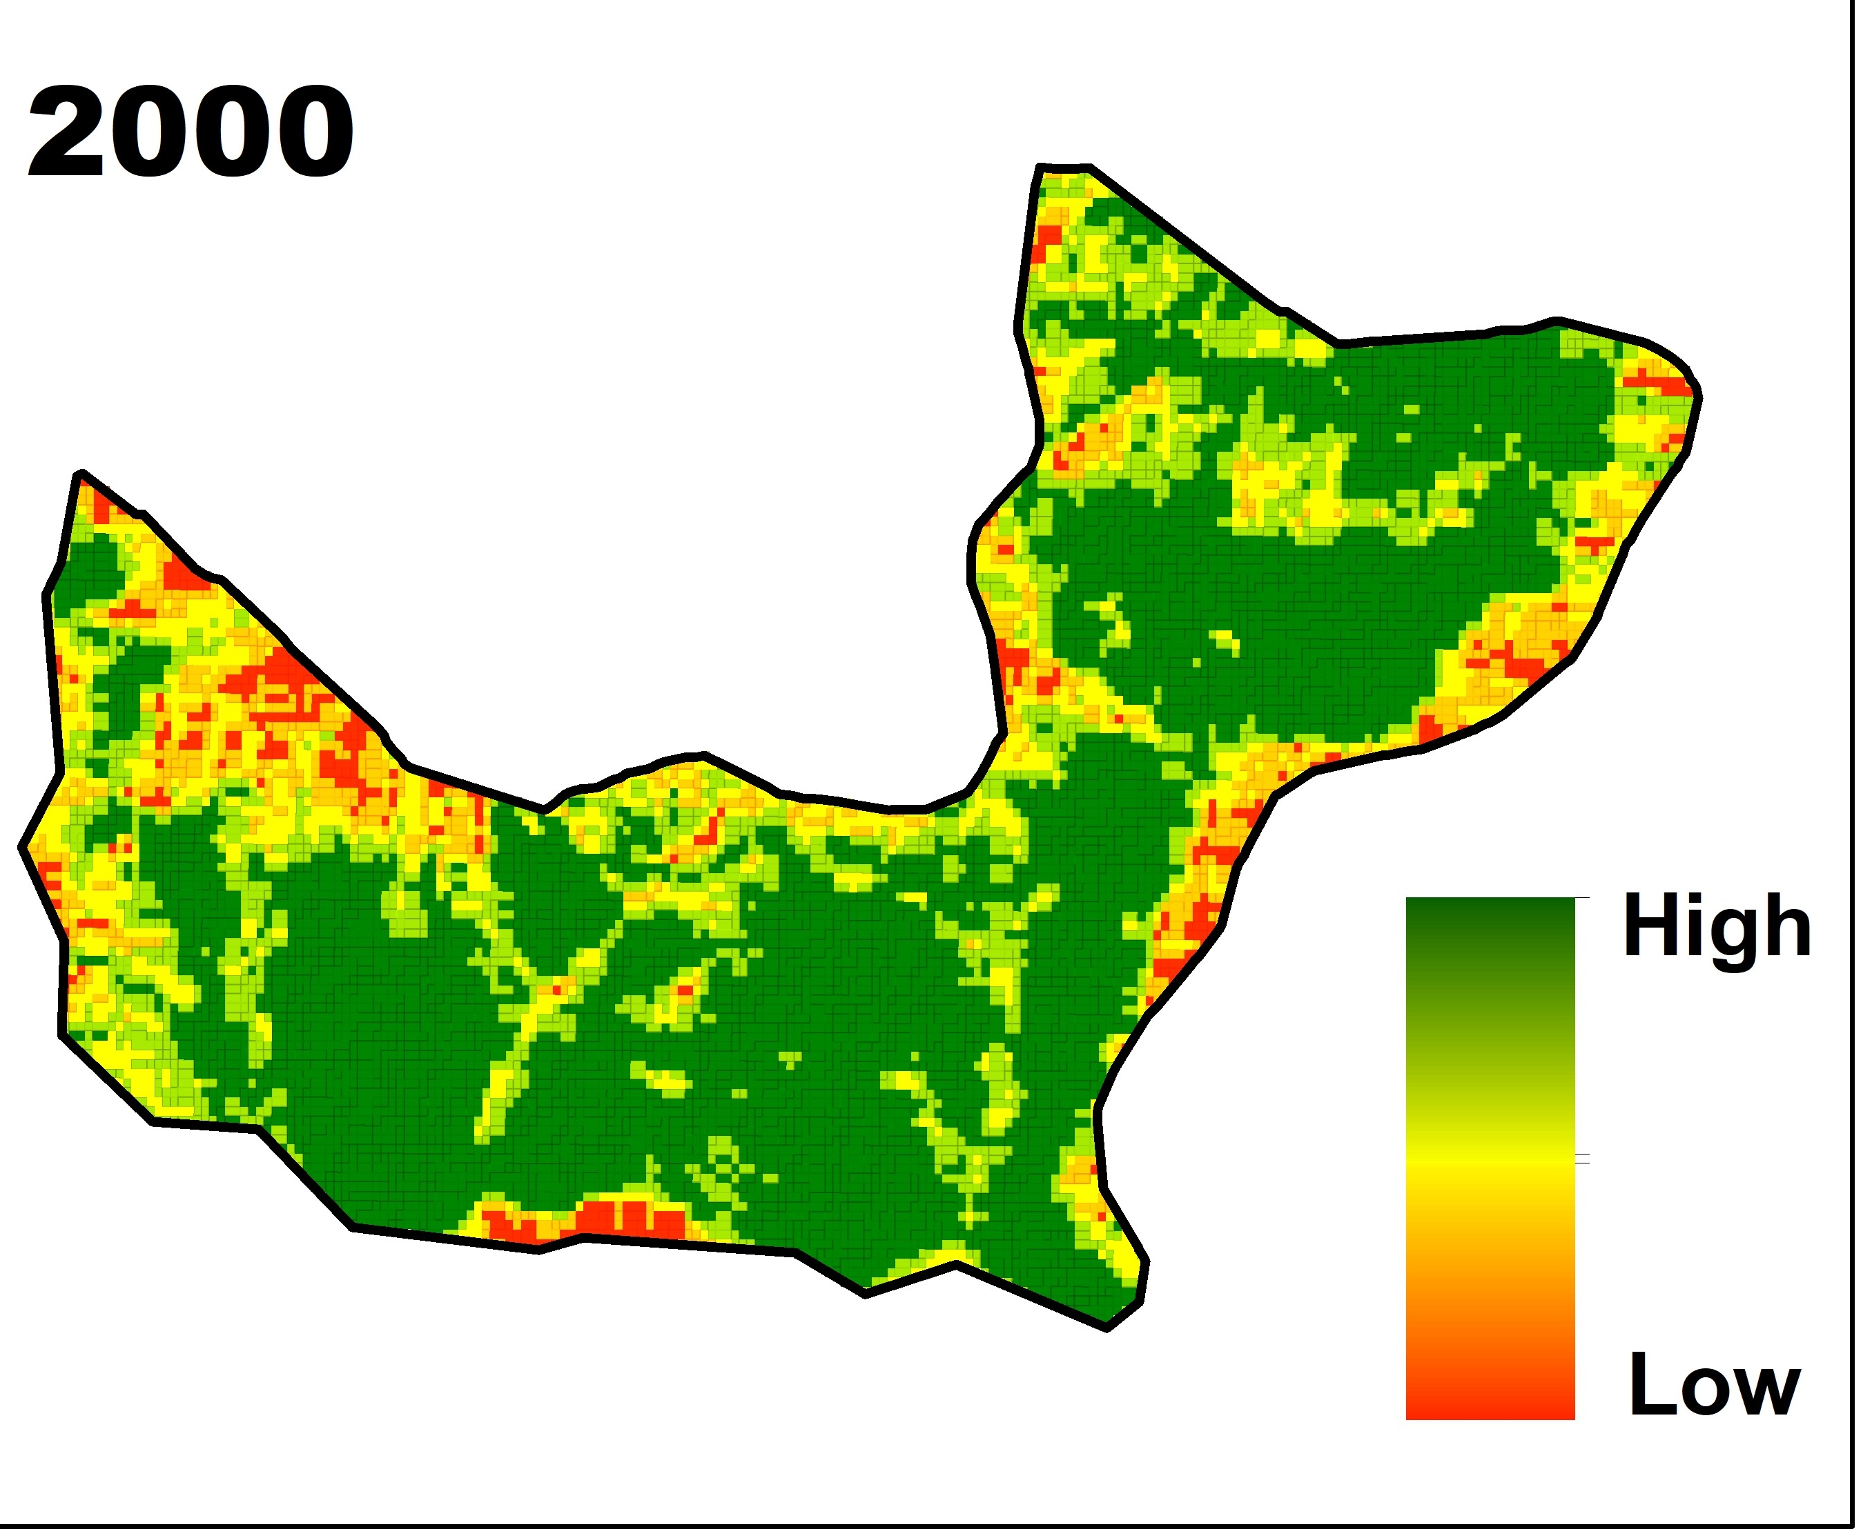
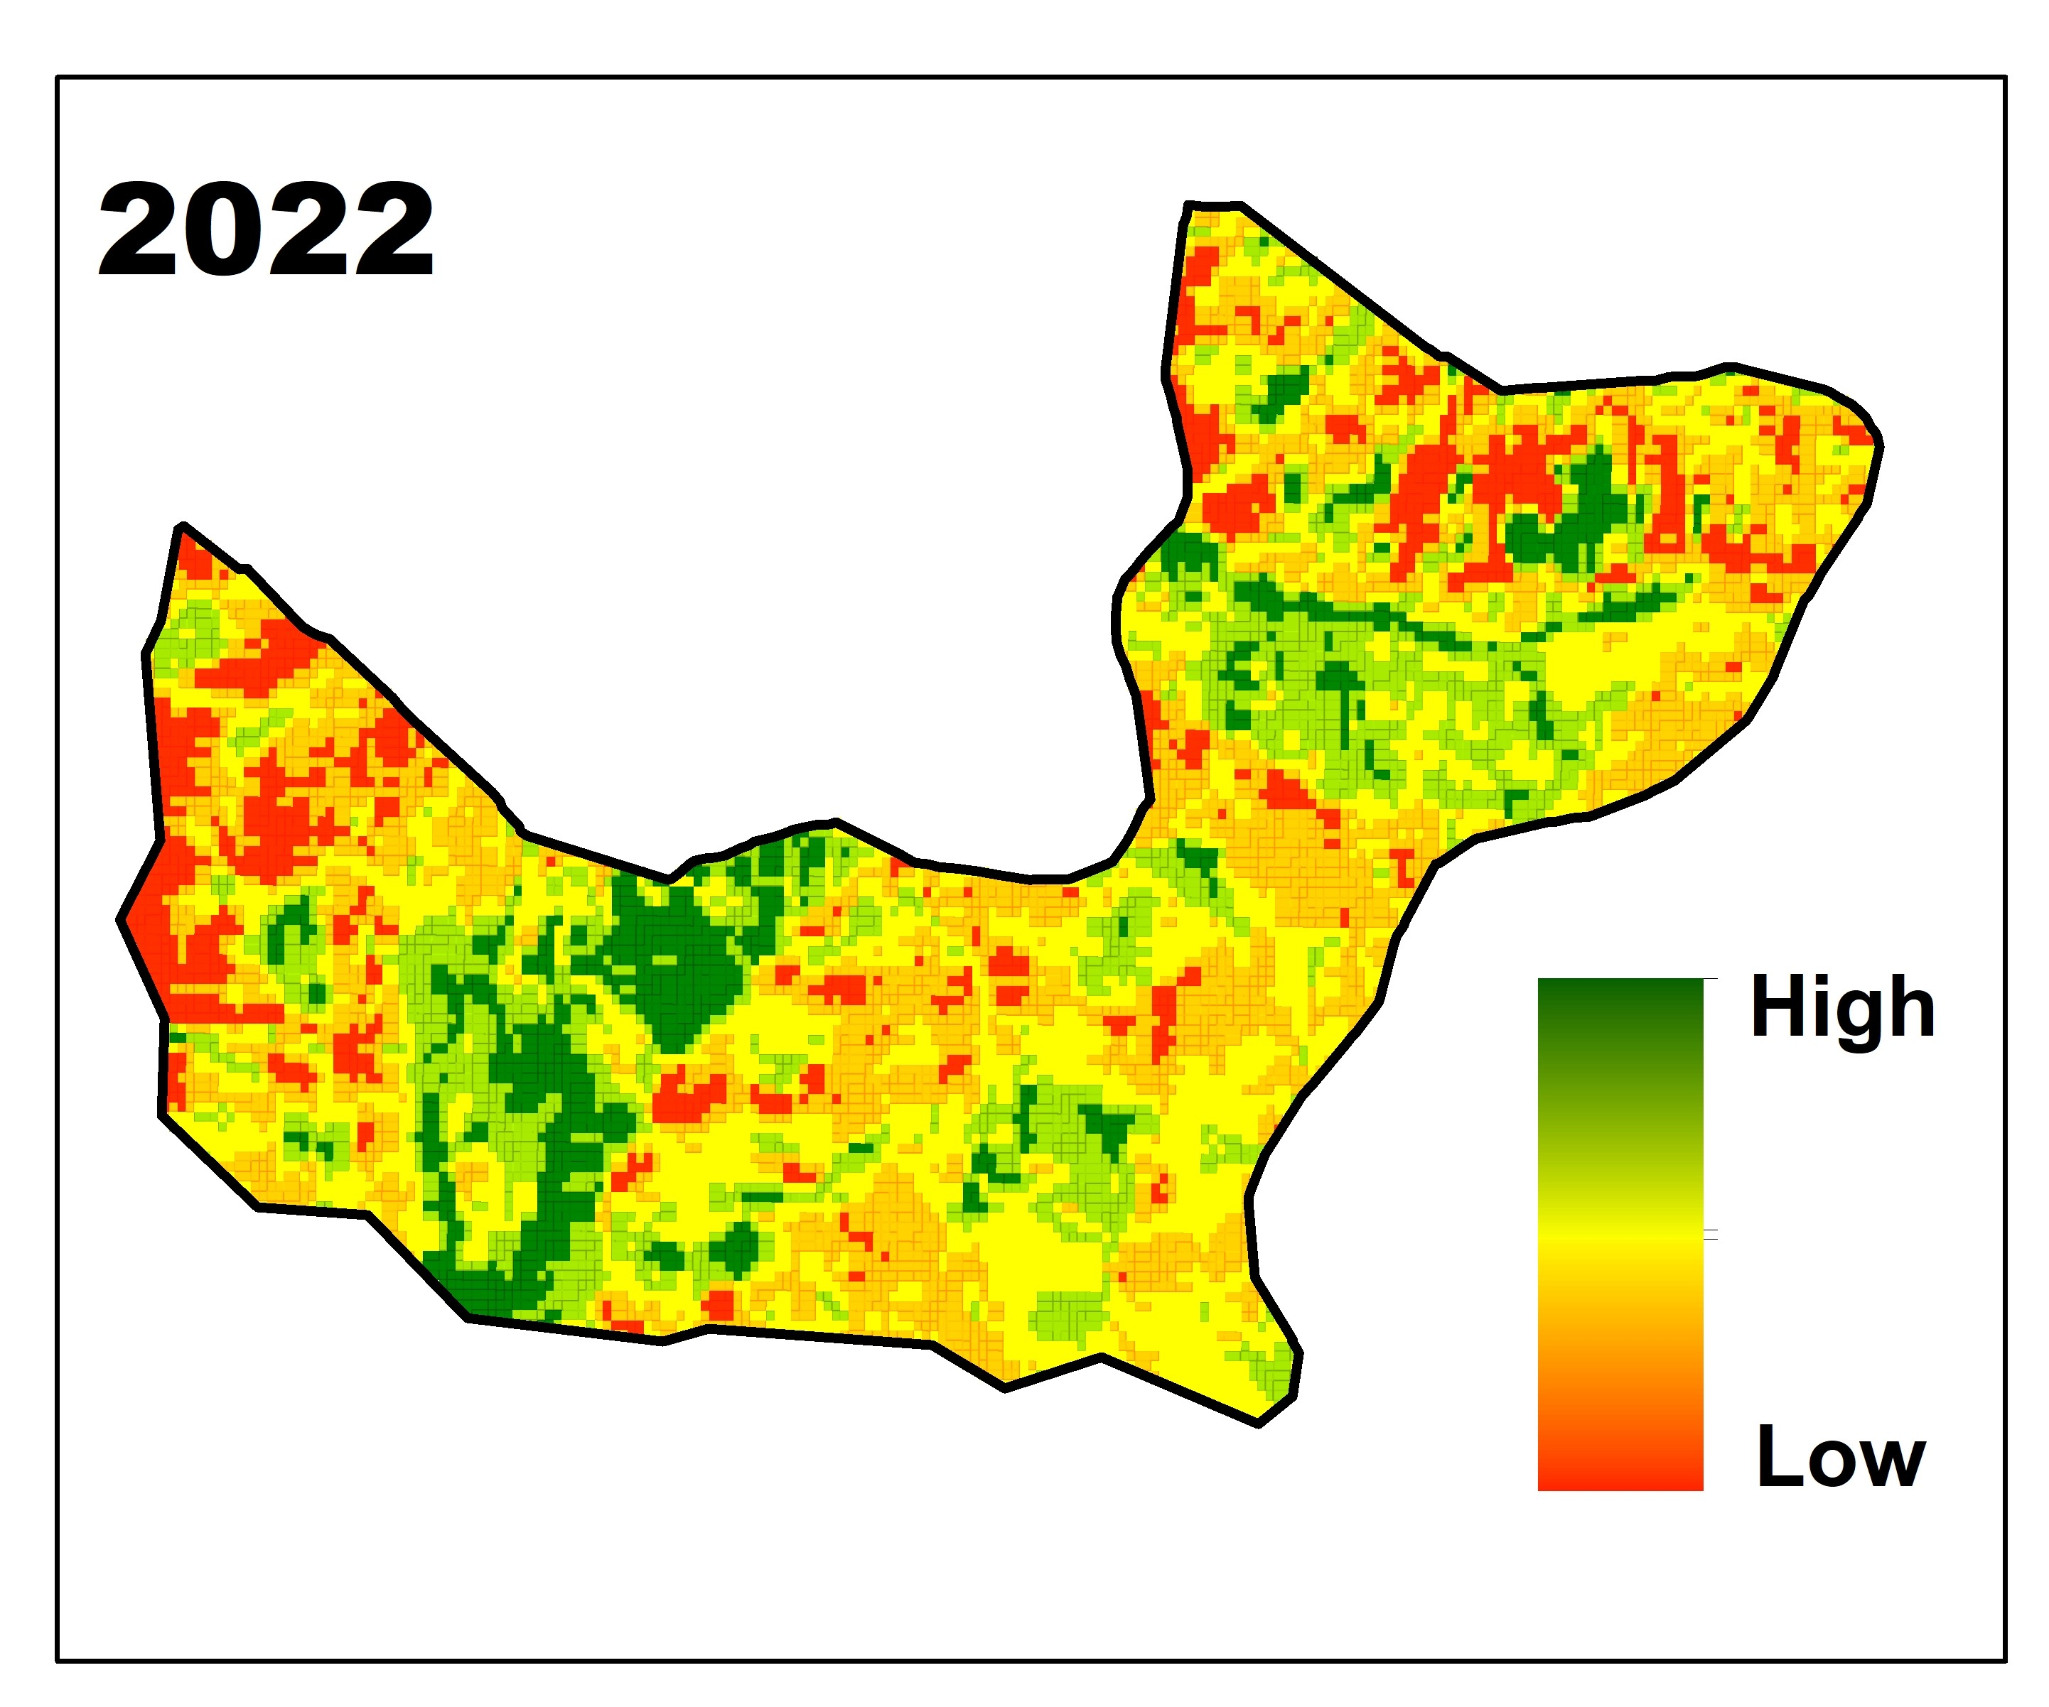

Slide 6
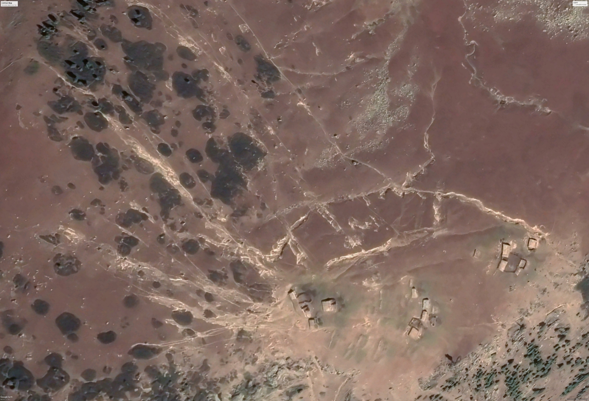
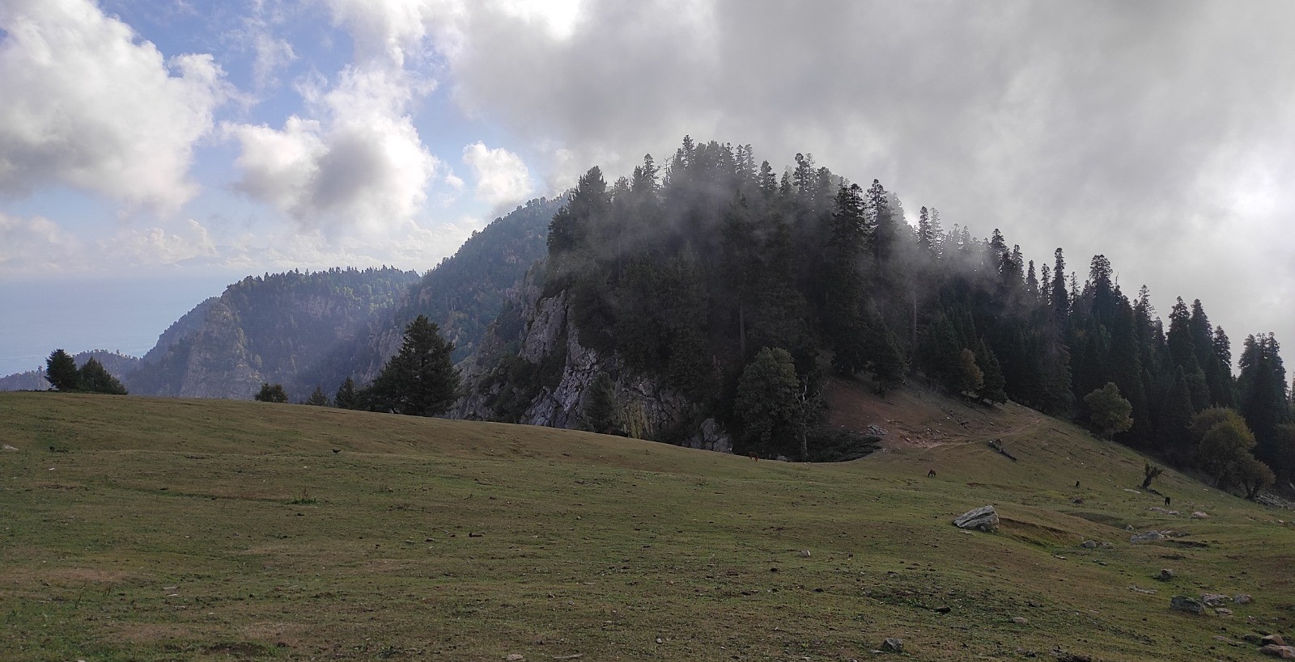
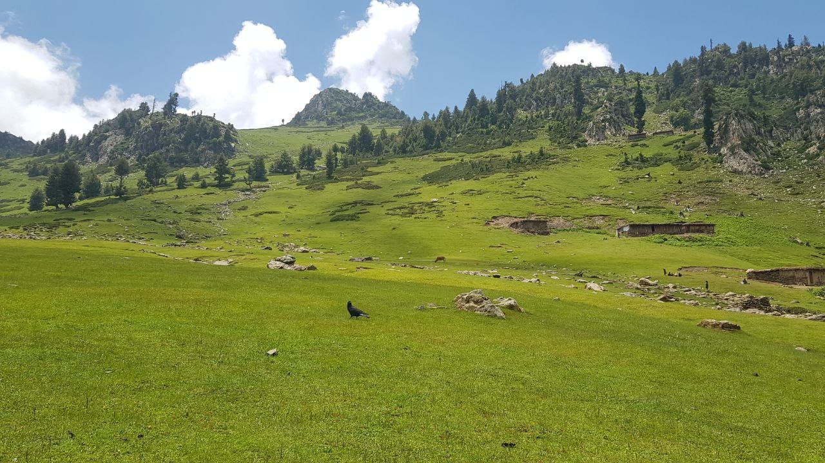
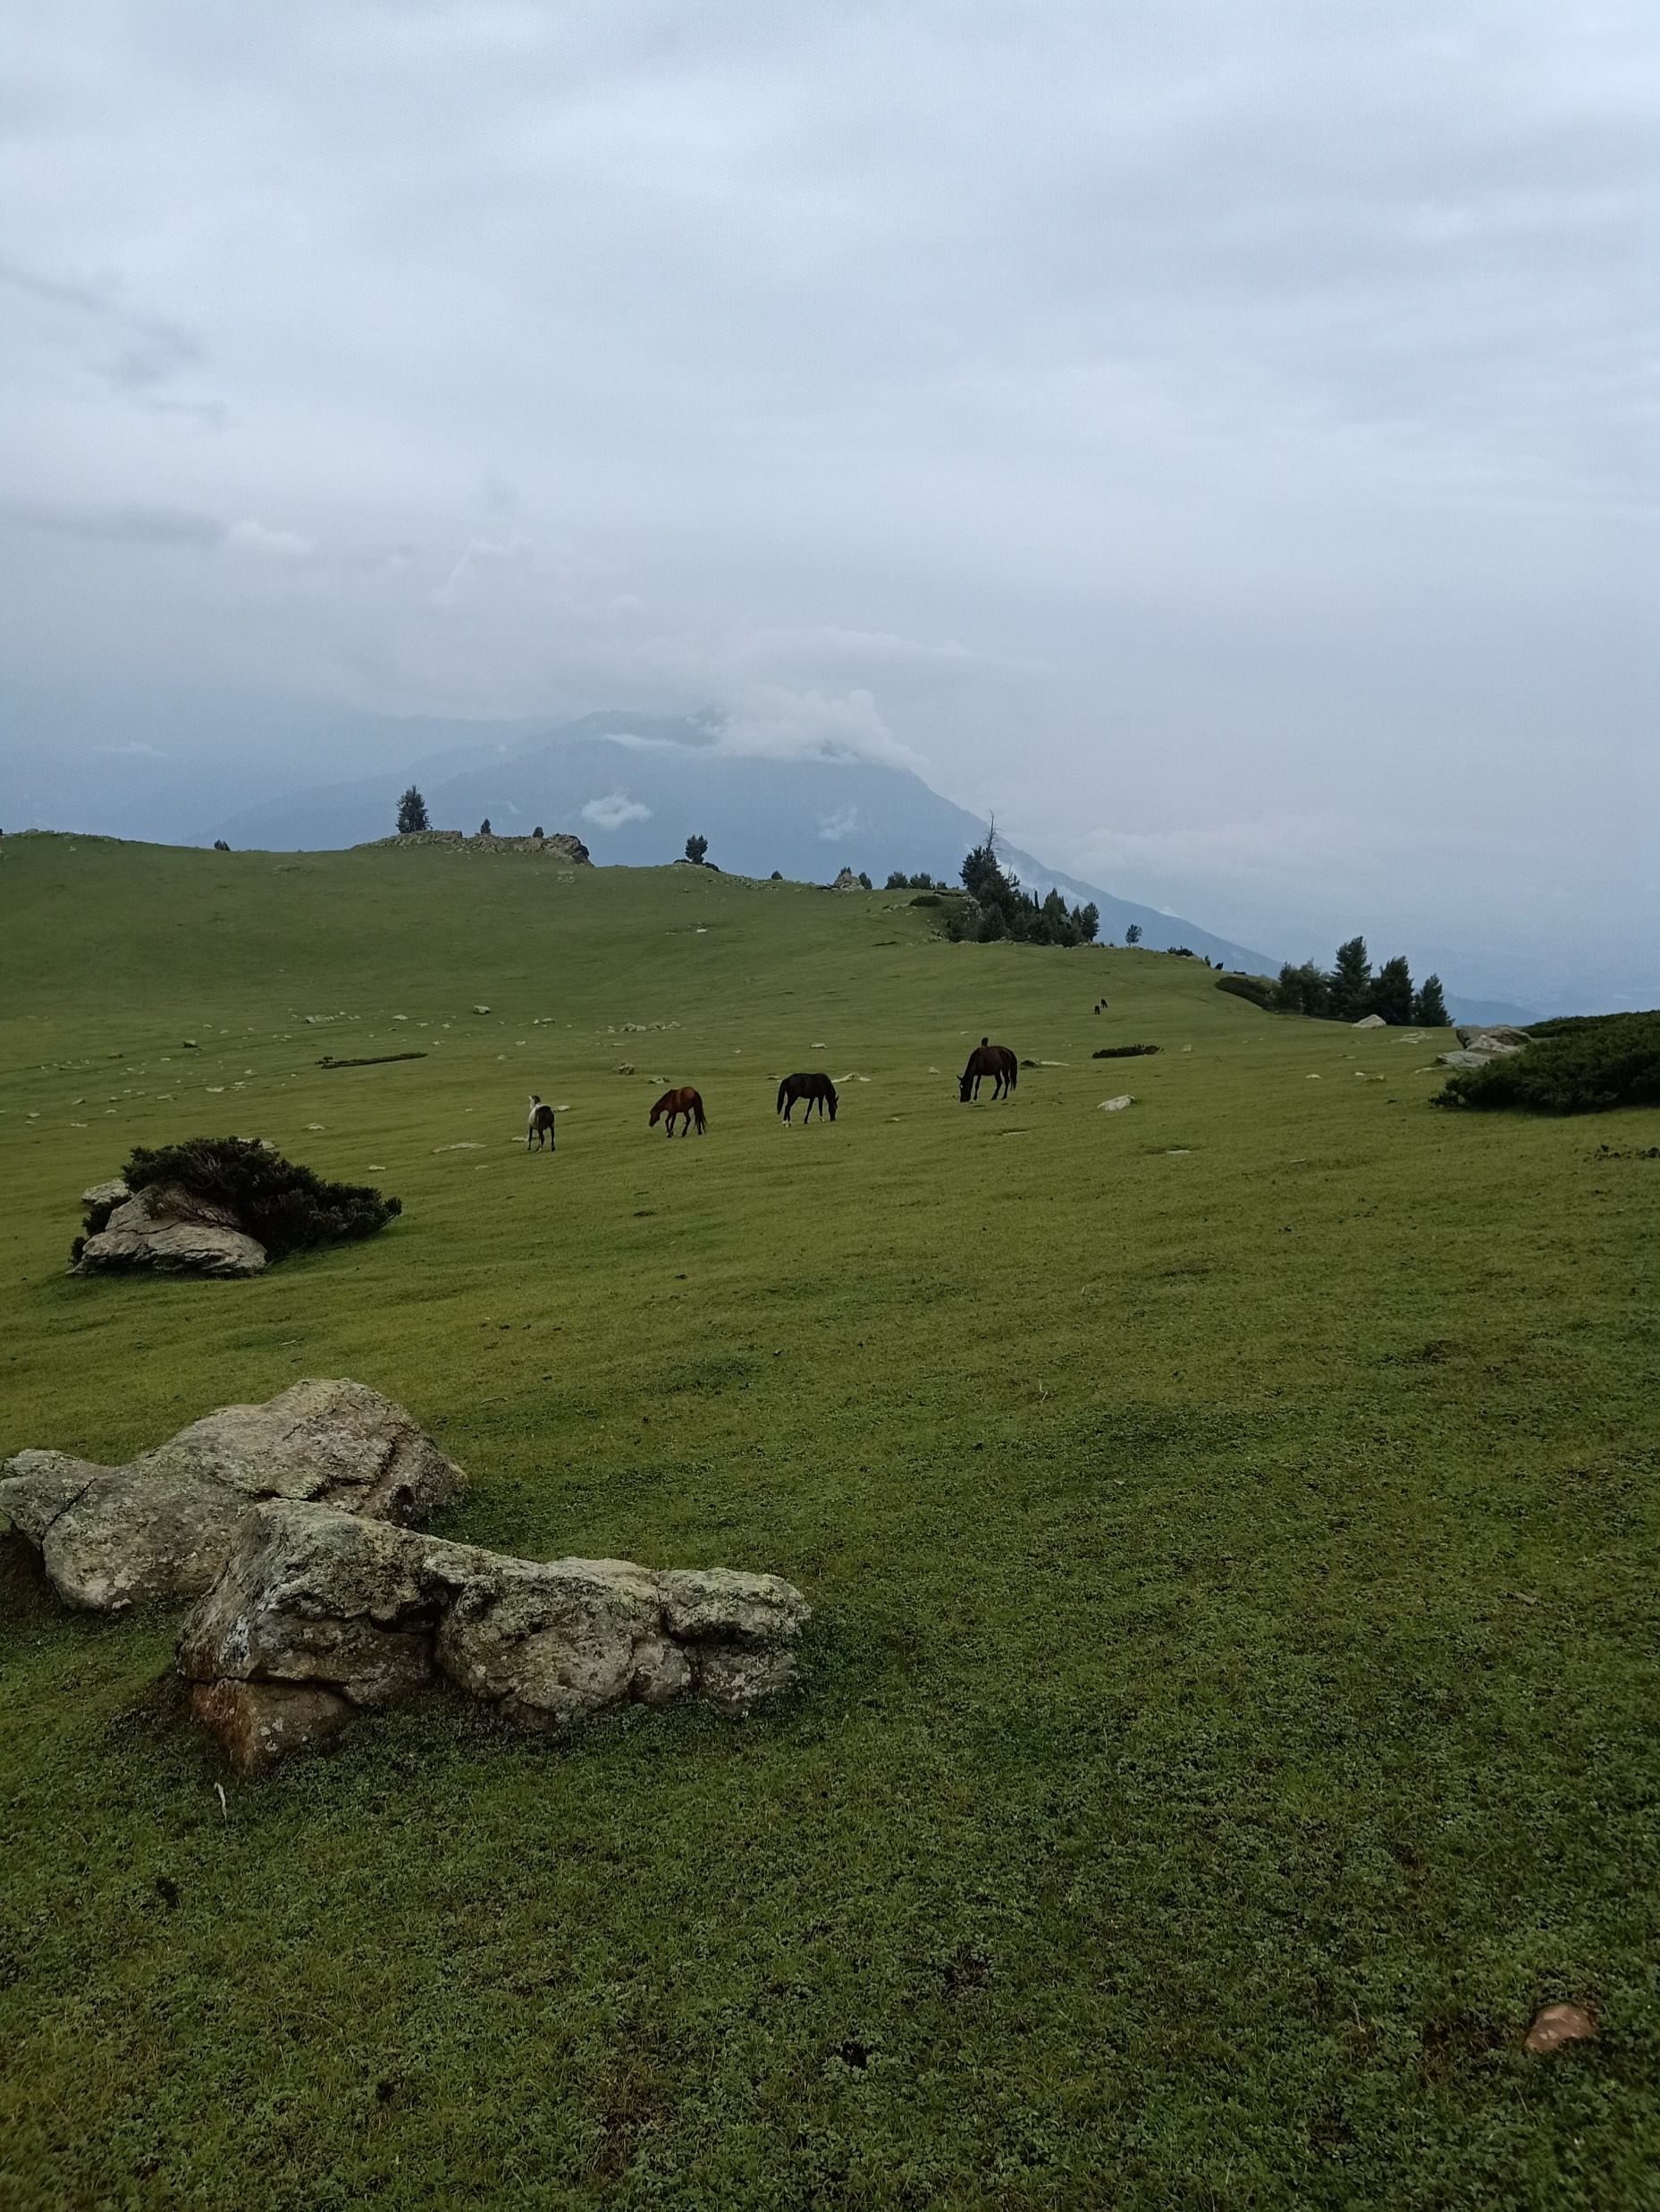
Restoration by Seeding
Stage wise Restoration Methods of Target Area
Limited Grazing
Rotational Grazing
Surplus Areas

Slide 7
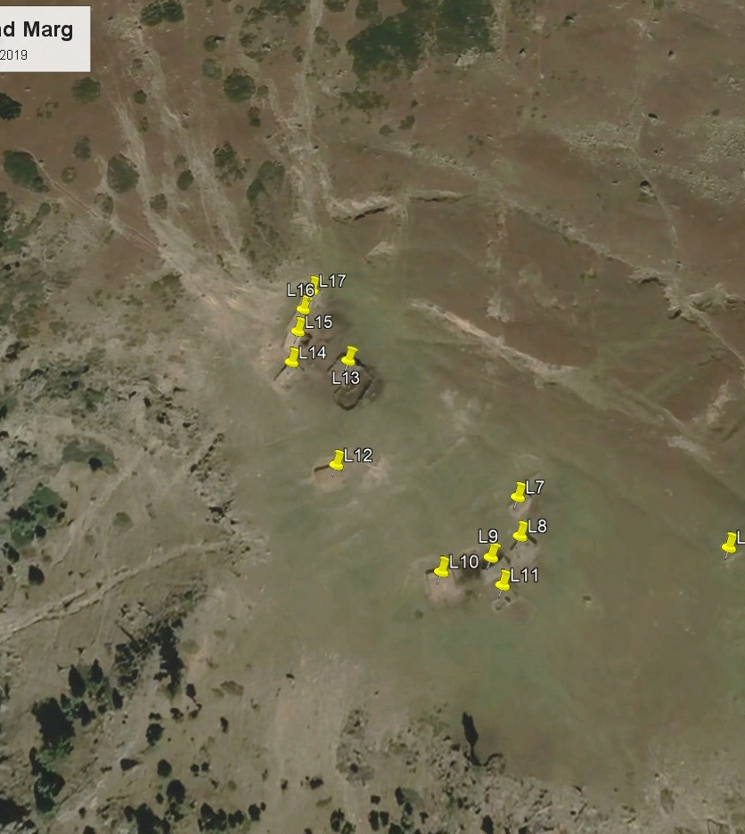
Settlement Near Water Sources
During their migration period, these pastoral tribes typically set up temporary settlements near water sources.
Water sources are essential for the sustenance of both the tribes and their livestock, making them ideal locations for temporary camps.
Livestock concentrate around water sources, leading to the overgrazing of selected parts of the pasture, which depletes the vegetation cover.

Slide 8
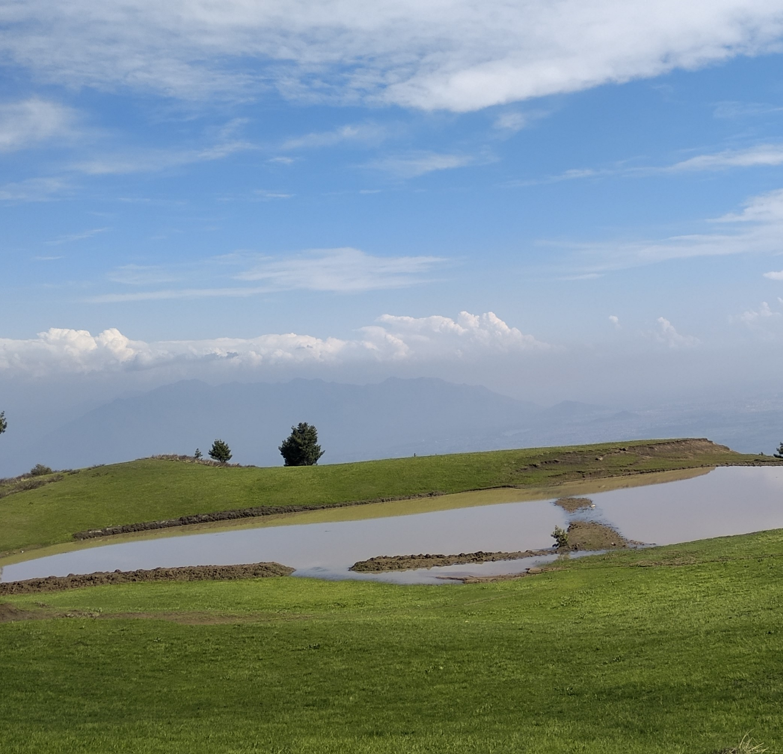
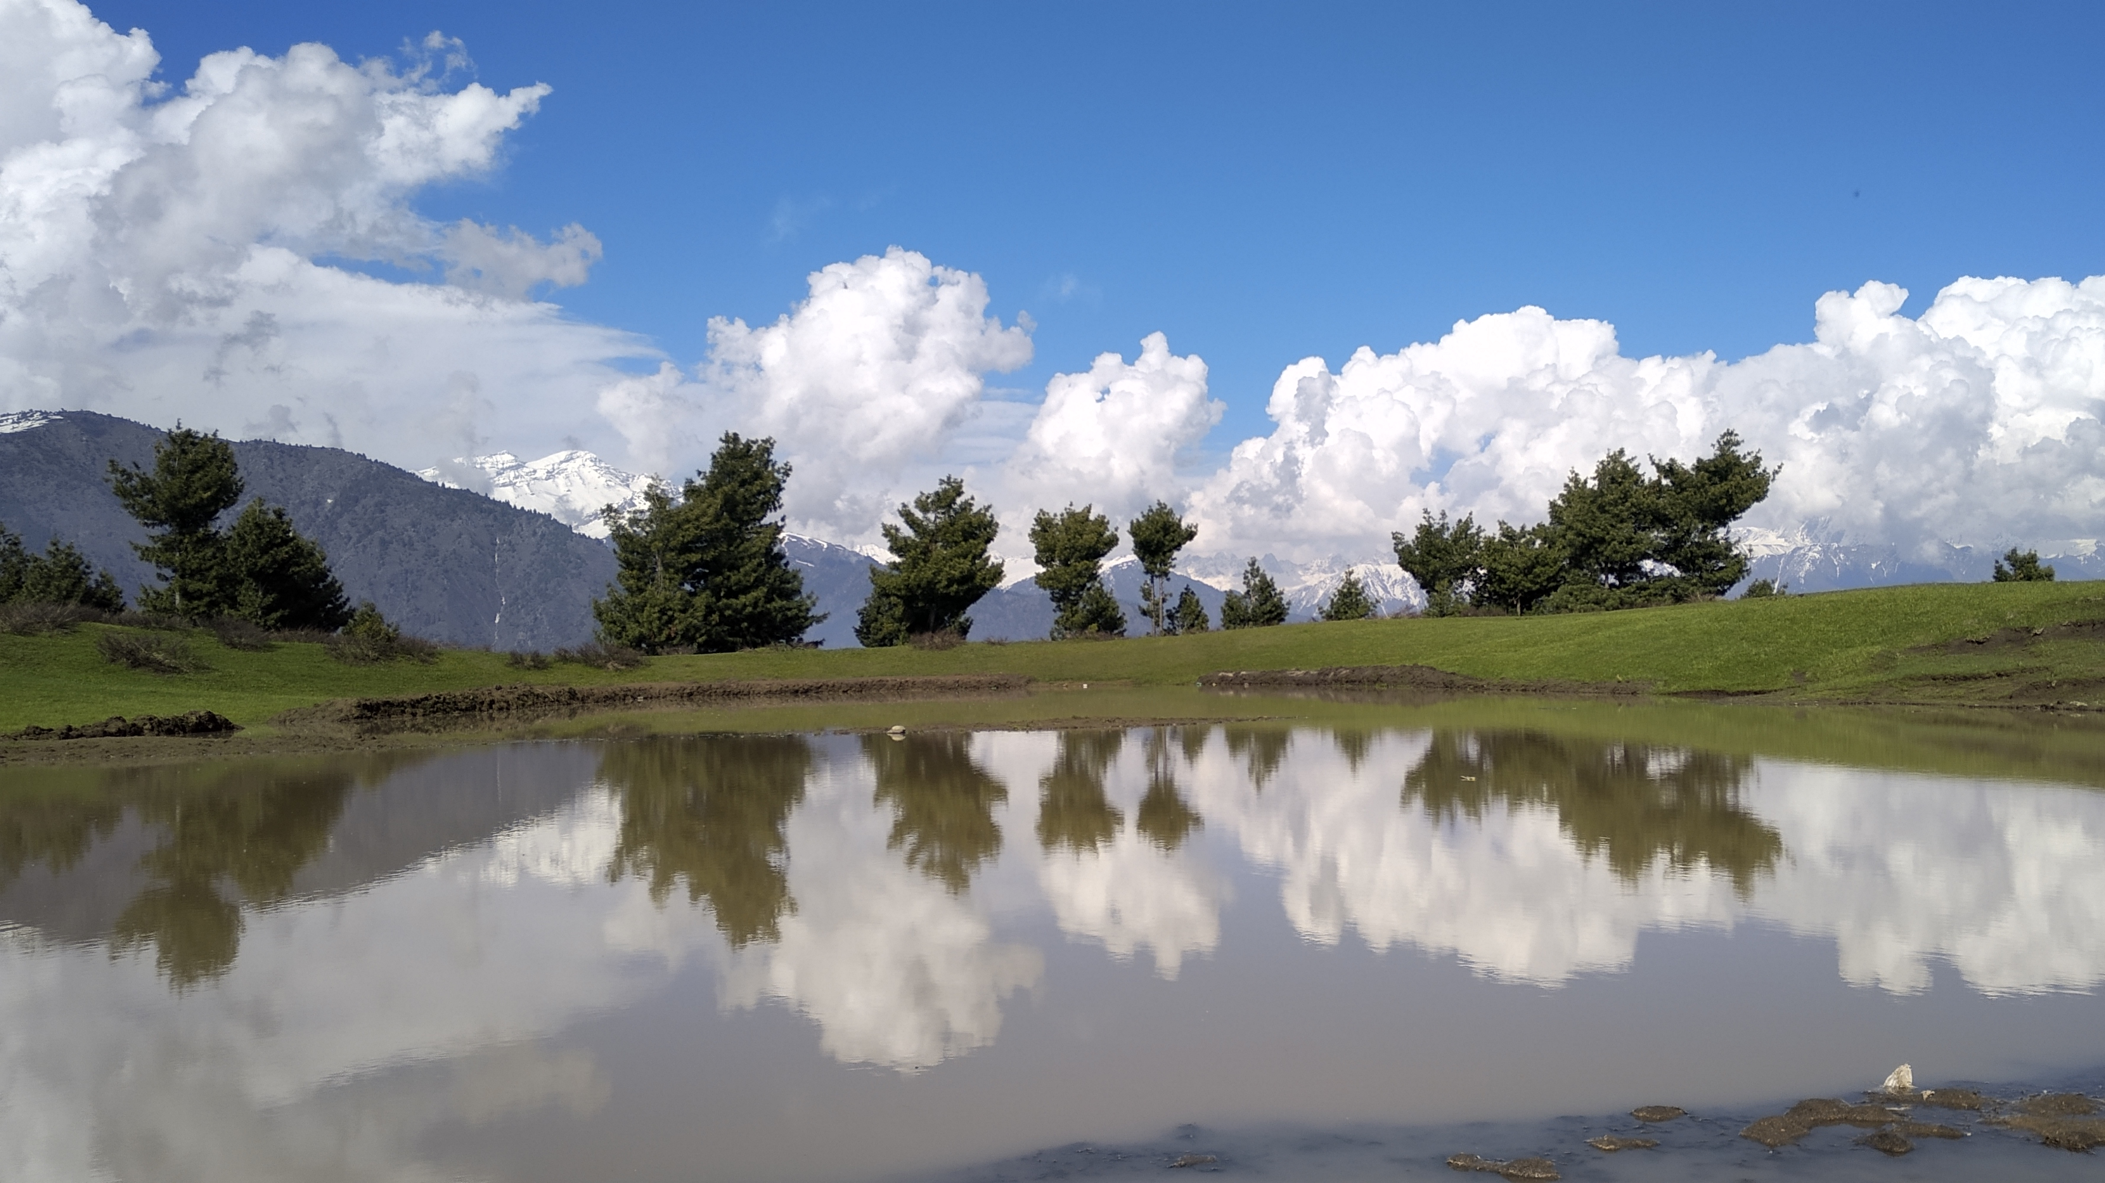

Slide 9
Way Forward
Construct Ponds: Build ponds in areas without perennial water sources to collect and store rainwater.
Distribute Grazing Pressure: Provide multiple water points to reduce grazing pressure around existing sources, preventing overgrazing in specific areas.
Benefits: Prevents overgrazing and allows vegetation recovery.
Improves livestock health by ensuring adequate water access.
Supports biodiversity by maintaining balanced ecosystems.

Slide 10
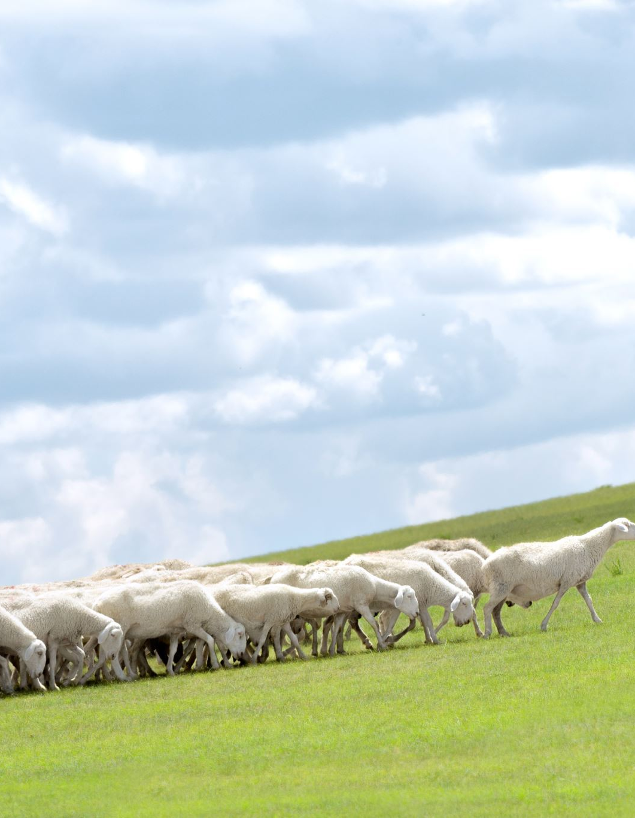
Sustainable Grazing Practices
Rotational Grazing: Implement rotational grazing to allow vegetation in overgrazed areas to recover.
Grazing Plans: Develop grazing plans that align with the land's carrying capacity for sustainable resource use.
Community Education and Involvement
Awareness Programs: Educate pastoral communities on sustainable practices and environmental conservation.
Adaptive Management: Adapt practices based on monitoring results and community feedback for continuous improvement.

Slide 11
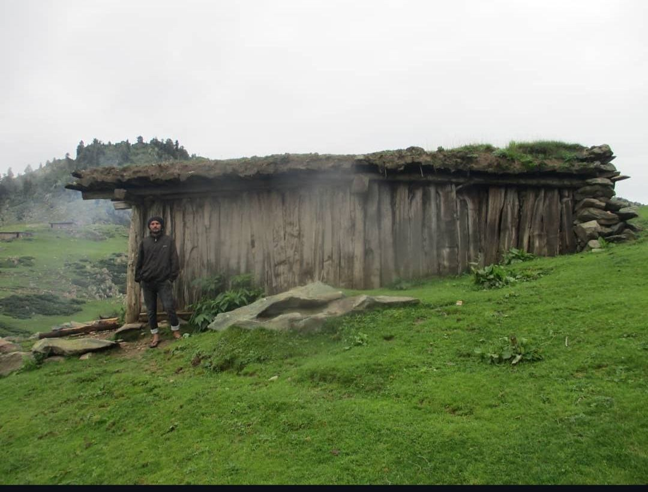
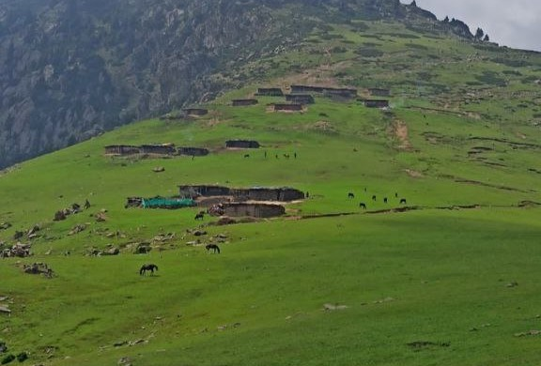
Thankyou…

